Slide 1
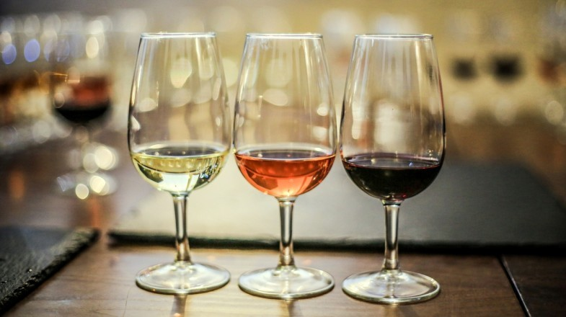
2020 Virtual Fall Conference
AFHE Virtual Wine Tasting: Lighter Wines for Summer Hosted by Laura Wartner, AFHE President, and Mike Whitty, AFHE Secretary and Wannabe Sommelier July 26, 2023

Slide 2
Welcome!
Join us for a delicious comparison of lighter, crisper wines well suited for serving chilled in warmer summer weather.
The following pages are from our May 20, 2021 AFHE virtual wine tasting, and are provided only as examples.
We encourage all attendees to select some lighter, crisper wines of their own choice, and we’ll give each attendee a chance to mention what they’re drinking and what they like about it.
Attendees are encouraged to teach us about some wines we may not already know, such as lighter wines from less-well-known growing regions. Example: Michigan Sauvignon Blanc.

Slide 3
Welcome! Notes from May 20, 2021
We will taste 4 different wines, two whites and two rosés.
We'll discuss the different qualities of the grape varietals and the different wine producing traditions for their producing regions.
Attendees are encouraged to purchase their own wine in advance to participate in the tasting. We will be tasting the following wines (all retailing between $17 and $25):

Slide 4
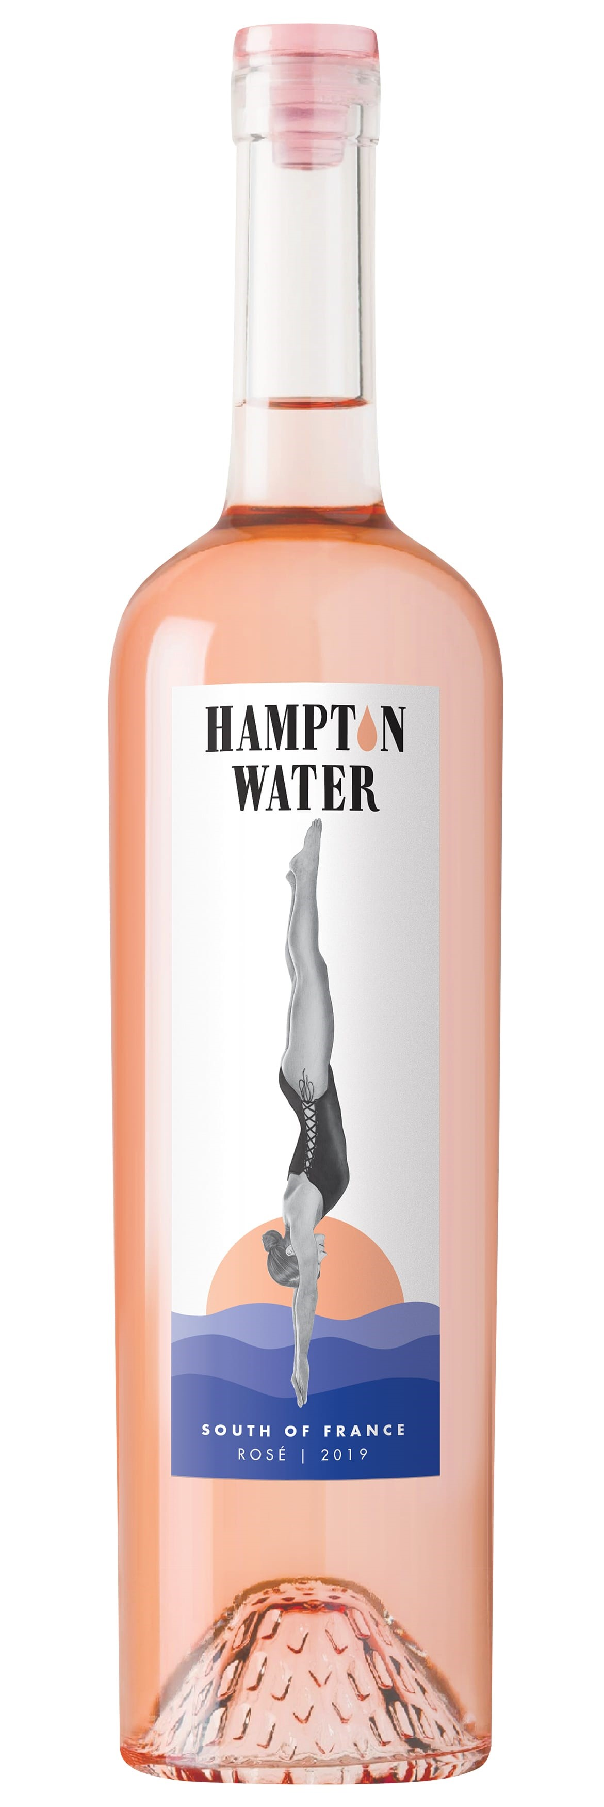
Our Four Wines

Slide 5
Geography
Today’s virtual tasting will feature light crisp wines that fit with summer weather, out at the beach or on a porch or patio.
Light crisp wines are grown all over the world in almost every wine region, but tend to be further toward the poles in each hemisphere.
As with most wine growing regions, these have some distinct minerality due to volcanic soils.

Slide 6
Examples of Regions Producing Crisp, Light Wines
Northern California, Cascadia
Germany
Veneto, Italy
Languedoc and Provence, France
New Zealand
South Africa
Chile, Argentina

Slide 7
Jules Taylor Sauvignon Blanc 2020
Marlborough region of New Zealand
Vibrant tropical and citrus aromas of passionfruit, lime and pink grapefruit leap from the glass, supported by exotic notes of lemongrass and Vietnamese mint.
This upfront, in-your-face drop captures the essence of Marlborough Sauvignon Blanc. The fruit flavors combine with mouthwatering intensity and juicy acidity, giving way to a long, zesty, perfectly balanced finish.
More information at Wine.Com
Other options or alternatives:
Oyster Bay Marlborough Sauvignon Blanc 2019
McBride Sisters Marlborough Sauvignon Blanc 2019
Kim Crawford Sauvignon Blanc 2020

Slide 8
Santa Margherita Pinot Grigio 2019
Veneto, Italy
The wine is dry with intense aromas and appealing flavors of Golden Delicious apples and citrus with a long, multi-layered finish. Excellent as an aperitif and with a medium body that makes it versatile to pair with everything from salads to chicken or grilled fish. Wonderful pairing ideas include butter lettuce with apples, walnuts, and pomegranate seeds, pizza topped with prosciutto and arugula, scallops, with tarragon cream, or tagliatelle with Italian olive oil, lemon zest and pine nuts.
More information at Wine.Com
Options or Alternatives:
Ruffino Pinot Grigio Lumina 2019
MacMurray Ranch Russian River Pinot Gris 2018

Slide 9
Rosé Wines
Rosé is more than just a compromise between red and white wine.
True, its production involves a very temporary absorption of color from the wine skin (for hours rather than days), compared to the longer term absorption in red wines and the non-absorption in white wines.
Rosé is not a new invention, but may be as old or older than red and white.
For marketing, most rosé tends to be light and crisp.

Slide 10
Sonoma-Cutrer Russian River Valley Rosé of Pinot Noir
Sonoma-Cutrer's 2020 Rosé of Pinot Noir is a beautiful and delicate example of why Russian River Valley Pinot Noir makes a wonderful rosé.
The beautiful, light salmon color of the wine catches the light in the glass and opens up with aromas of blueberry, pink grapefruit, cantaloupe and a light hint of rose petal.
A crisp, refreshing mouthfeel accentuates the fresh fruit flavors of citrus, strawberry and blood orange. The wine finishes long and tangy. It is the perfect warm weather wine to enjoy all summer long.
More information at Wine.Com

Slide 11
Alternative Options for American Rosé
Pinot Noir Rosés:
Flowers Sonoma Coast Rose 2020 (my substitute)
La Crema Pinot Noir Rosé 2019 (Monterey CA)
Willamette Valley Vineyards Whole Cluster Rosé of Pinot Noir 2019 (OR)
Sparkling Rosé:
Chateau St. Jean Sparkling Rosé (WA)

Slide 12
Hampton Water Rosé 2020
From Languedoc in south central France. Languedoc that may never catch up to Bordeaux and Burgundy, but it has come a long way, and is no longer just producing table wine for the domestic market but is producing some wine for export.
This Rosé is fresh and lively with distinct minerality and a long-lasting finish, intensified by aging in French oak barrels. Its intense aromas of red fruit, citrus fruit, and spices make it another perfect companion to be shared among friends.
More information at Wine.Com
Virtual Wine Tasting Hosted by Wine Investor John Bon Jovi

Slide 13
Alternative Options for French Rosé
Chateau d'Esclans Whispering Angel Rose 2020 from Provence, Southeast France (my substitute for the day)
“Whispering Angel is today’s worldwide reference for Provence rosé. Made from Grenache, Cinsault and Rolle (Vermentino), its pale color is pleasing to the eye and draws one in. The rewarding taste profile is full and lush while being bone dry with a smooth finish.
Highly approachable and enjoyable with a broad range of cuisine.”
Fleur de Mer Rosé 2019 Rosé from Cotes de Provence, Southeast France

Slide 14
Thanks for participating!
For further reading / watching:
Lettie Teague in WSJ on virtual wine tastings
Wine at the movies (with links to IMBD.com):
“Red Obsession” (2013) – about a burst of Chinese interest in Bordeaux and its effects on prices and vineyards
“Bottle Shock” (2008) – Dramatic retelling of the story of the 1976 Paris wine tasting when Napa wines surprised the French, featuring Chris Pine, Alan Rickman, Eliza Dushku, Bill Pullman, Dennis Farina
“Sideways” (2004) (R) Wine-tasting buddy road-trip featuring Paul Giamatti, Virginia Madsen, Thomas Haden Church, Sandra Oh (single-handedly killed the Merlot boom)

